Slide 1
Women in Tech in Nigeria: Employment and Retention Patterns Prepared by: Mbakpobe Adaeze Ebele
Data Analysis Project Powered by Survey, NITDA, World Bank, and TechCabal Data

Slide 2
Project Overview
This project explores employment and retention patterns among women in tech in Nigeria.
It leverages survey responses, NITDA’s IgniteHer initiative, World Bank gender data, and TechCabal reports.
Goal: Understand challenges, highlight trends, and recommend strategies to retain women in tech.

Slide 3
Women in Nigeria's tech sector are underrepresented and face unique career challenges. There's limited data on their employment and retention experiences. this gap hinders targeted support and inclusive policy development.
PPROBLEM STATEMENT

Slide 4
We Designed and conducted a survey to collect first-hand data on women's experiences in Nigeria’s tech sector. We analyzed the responses alongside external data from NITDA, TechCabal, and the World Bank. We generated insights and visualizations to highlight patterns in employment, challenges, and retention—supporting recommendations for targeted intervention.
PROBLEM SOLUTION

Slide 5
Key Survey Insights
Majority (84%) of participants are in early-career stage (0–1 years experience).
Largest role represented: Data Analysts (23 out of 38).
Top locations: Anambra and Lagos
60% have considered leaving tech. Suggested Retention Solutions: Mentorship, Funding, Career Growth Opportunities.

Slide 6

🟣 5-day intensive program by NITDA in partnership with JICA. 🟣 Aimed at empowering women entrepreneurs with business and digital skills. 🟣 Focus on bridging gender gaps in digital literacy and access to funding. 🟣 Supports economic inclusion and national development via women-led innovation. 🟣 Emphasizes the role of strategic partnerships and mentorship in women’s success. 🟣 Reinforces the need for targeted programs to boost retention and advancement of women in tech.
NITDA IgniteHer Bootcamp

Slide 7
Empowering Women Entrepreneurs
A five-day intensive program launched in collaboration with JICA.
Focus: Digital literacy, financial inclusion, and business strategy.
Supports survey findings around the need for training, mentorship, and visibility.
Reinforces the importance of inclusive programs to improve retention.

Slide 8
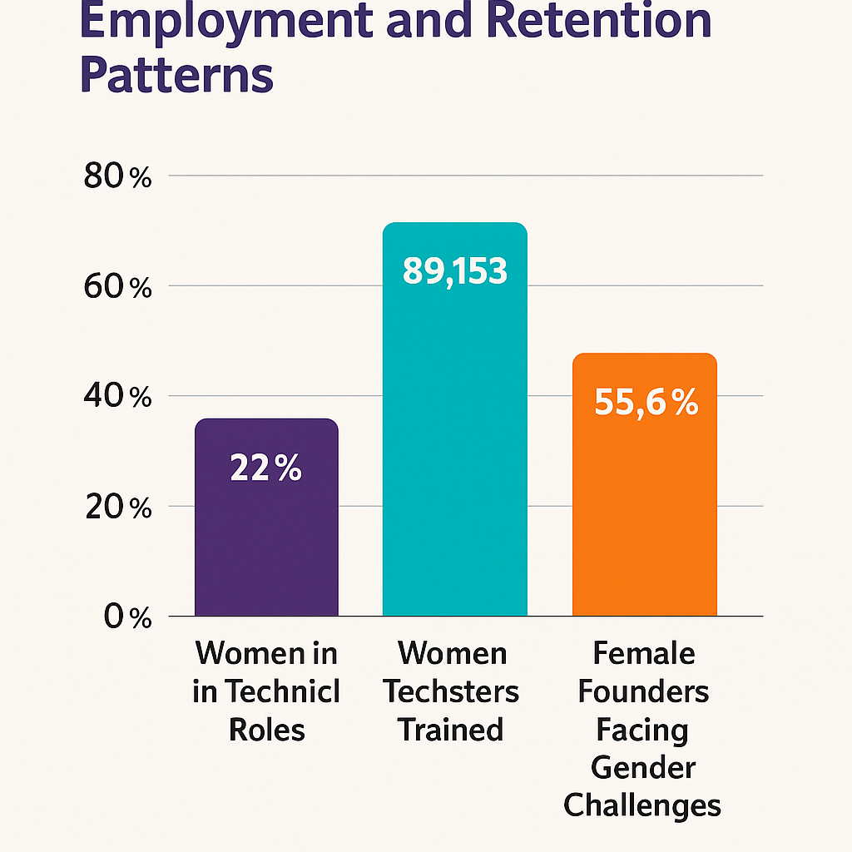
X-axis: Metric Y-axis: Percentage / Count Bars: Women in Technical Roles (22%) Women Techsters Trained (89,153) Founders Facing Gender Challenges (55.6%)
TechCabal Data Insights
Metric | Value | Year
Women in technical roles | 22% | 2022
Women trained by Women Techsters | 89,153 | 2023
Female founders facing gender-specific challenges | 55.6% | 2022

Slide 9
TechCabal Metrics (2022–2023)
22% of technical roles held by women (2022).
89,153 women trained by Women Techsters (2023).
55.6% of female founders face gender-specific challenges.
These align with survey concerns about equity and support systems.

Slide 10
Selected Indicators (Nigeria)
Female employment in industry rose from 12.3% (2015) to 17.7% (2023).
Legal parity: Women can get jobs, work nights, and register businesses like men (2015–2023).
Digital use by women to shop online remains low (2.16% in 2017; 2.73% in 2021).
No data yet on female STEM graduates — a data gap to note.

Slide 11
Recommendations
Expand access to mentorship, internships, and upskilling programs.
Promote visibility of women in tech through events and bootcamps.
Standardize data collection in surveys for accurate analysis.
Strengthen partnerships like NITDA–JICA to scale successful programs.

Slide 12
Conclusion
Women in tech face clear challenges — but also show strong interest and potential.
Policies and programs that reduce drop-off and increase engagement are essential.
Insights from this project can inform stakeholders, policymakers, and educators.
Let's create a more inclusive and thriving tech ecosystem in Nigeria.

Slide 13
Dashboard Summary
🧍 Early Career Participants: 84% (0–1 years)
Most Common Role: Data Analyst (60%)
DISTRIBUTION OF EXPERIENCE IN YEARS
Top Locations: Anambra & Lagos
Considered Leaving Tech: 60%
Distribution of Current Role Vs Experience
Top Retention Suggestions: Mentorship, Internships, Funding
Distribution of count of location

